Slide 1
Section 10.2
Polar Equations
and Graphs
Copyright © 2012 Pearson Education, Inc. Publishing as Prentice Hall.

Slide 2
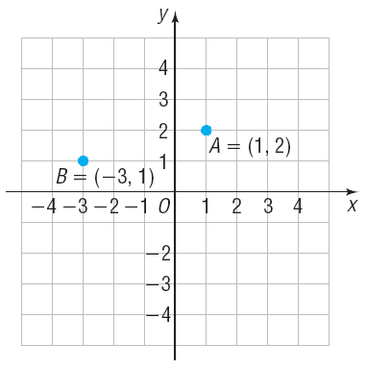
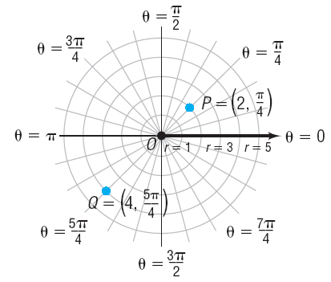


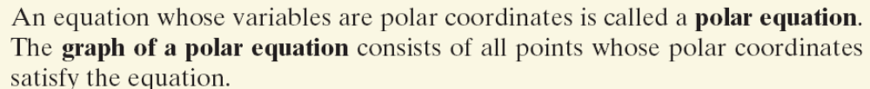
Copyright © 2012 Pearson Education, Inc. Publishing as Prentice Hall.

Slide 3

Copyright © 2012 Pearson Education, Inc. Publishing as Prentice Hall.

Slide 4

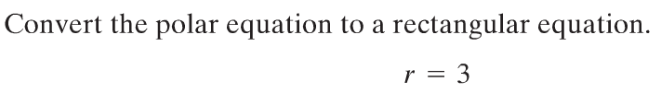
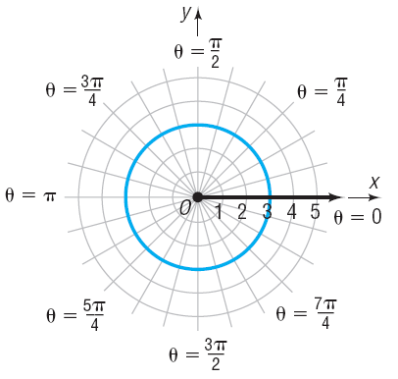



Copyright © 2012 Pearson Education, Inc. Publishing as Prentice Hall.

Slide 5


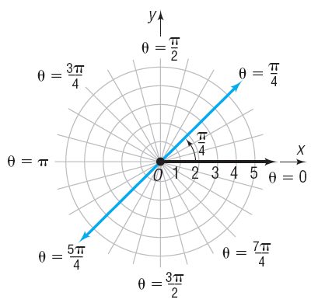



Copyright © 2012 Pearson Education, Inc. Publishing as Prentice Hall.

Slide 6
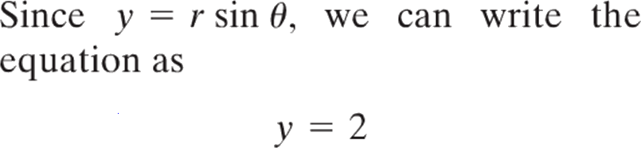
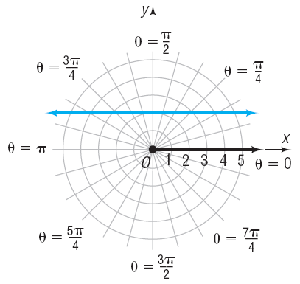
Copyright © 2012 Pearson Education, Inc. Publishing as Prentice Hall.

Slide 7
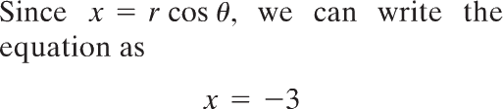
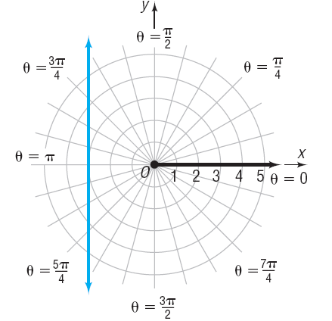

Copyright © 2012 Pearson Education, Inc. Publishing as Prentice Hall.

Slide 8

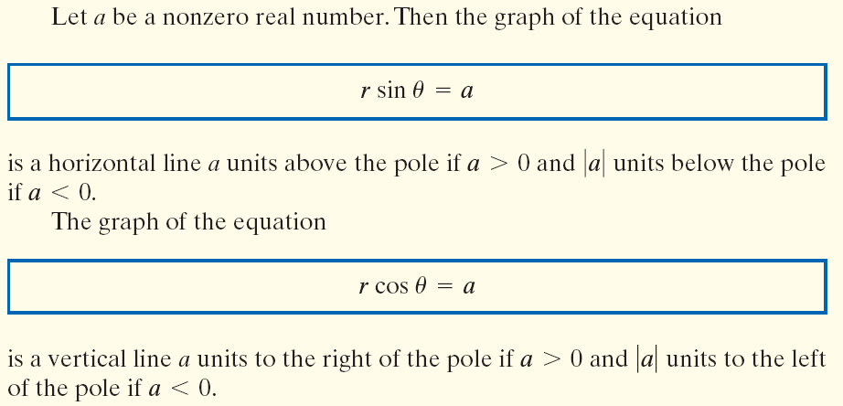
Copyright © 2012 Pearson Education, Inc. Publishing as Prentice Hall.

Slide 9
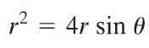
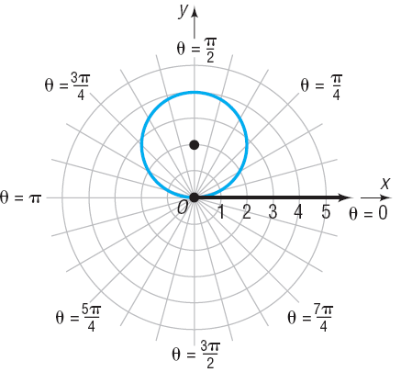




multiply by sides by r
Copyright © 2012 Pearson Education, Inc. Publishing as Prentice Hall.

Slide 10


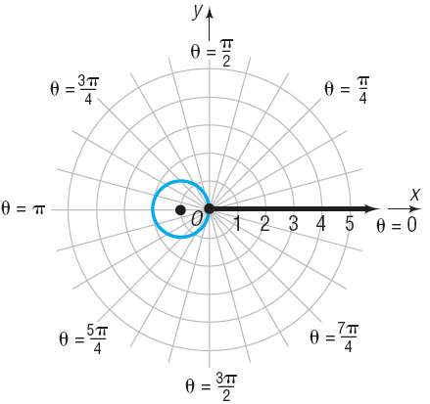



Copyright © 2012 Pearson Education, Inc. Publishing as Prentice Hall.

Slide 11

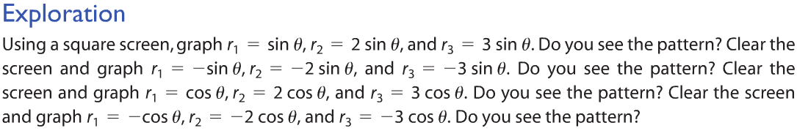




Copyright © 2012 Pearson Education, Inc. Publishing as Prentice Hall.

Slide 12
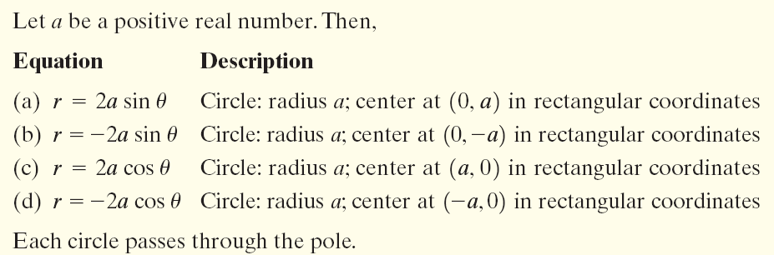
Copyright © 2012 Pearson Education, Inc. Publishing as Prentice Hall.

Slide 13
Copyright © 2012 Pearson Education, Inc. Publishing as Prentice Hall.

Slide 14
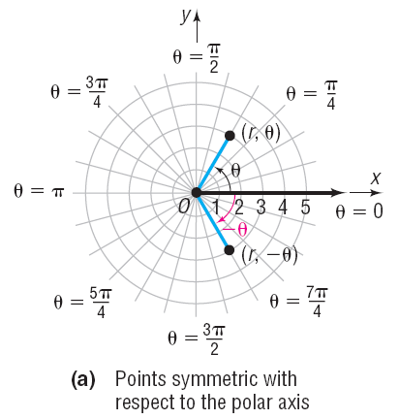
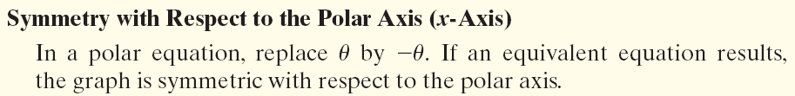
Copyright © 2012 Pearson Education, Inc. Publishing as Prentice Hall.

Slide 15
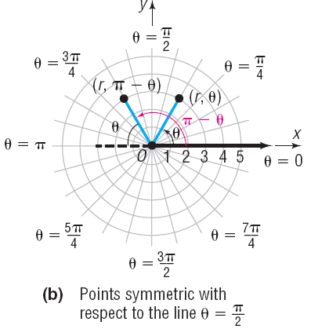
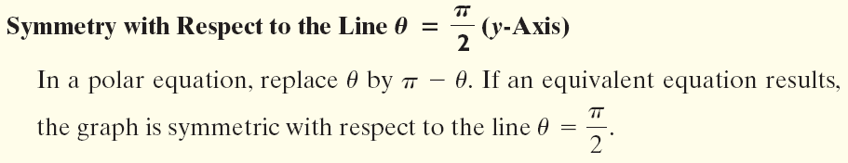
Copyright © 2012 Pearson Education, Inc. Publishing as Prentice Hall.

Slide 16
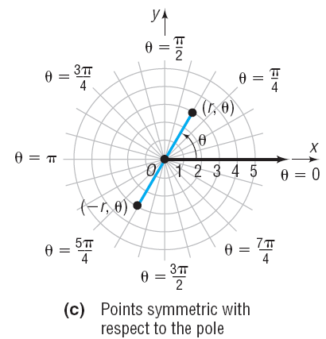
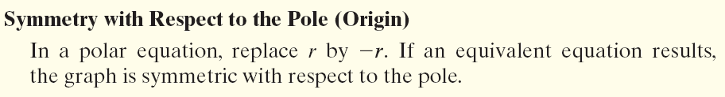
Copyright © 2012 Pearson Education, Inc. Publishing as Prentice Hall.

Slide 17
Copyright © 2012 Pearson Education, Inc. Publishing as Prentice Hall.

Slide 18

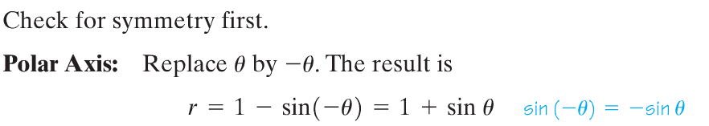
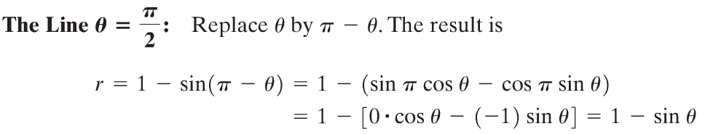
Copyright © 2012 Pearson Education, Inc. Publishing as Prentice Hall.

Slide 19
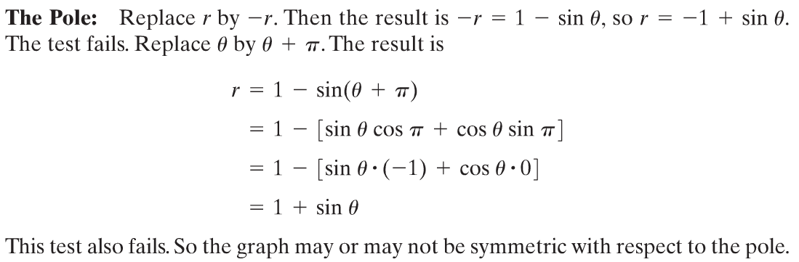
Copyright © 2012 Pearson Education, Inc. Publishing as Prentice Hall.

Slide 20
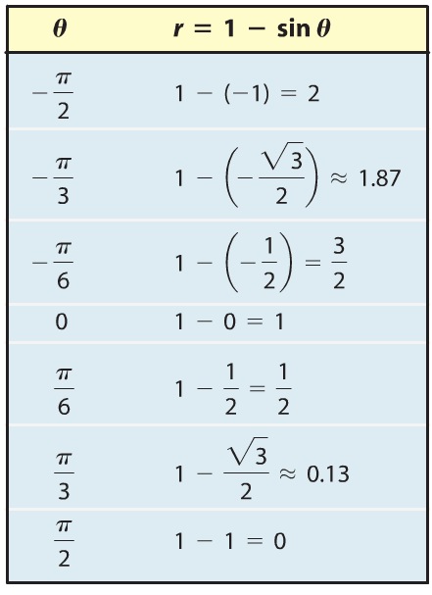
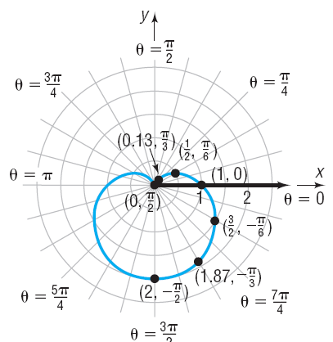
Copyright © 2012 Pearson Education, Inc. Publishing as Prentice Hall.

Slide 21
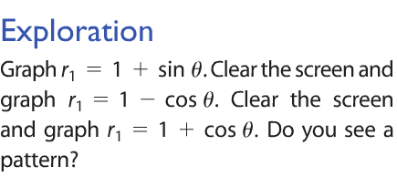



Copyright © 2012 Pearson Education, Inc. Publishing as Prentice Hall.

Slide 22
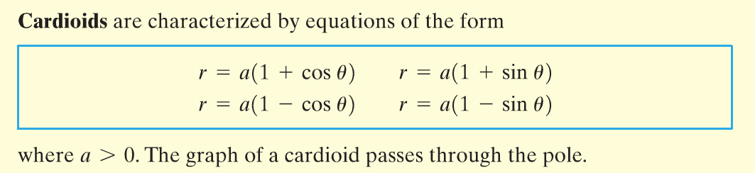
Copyright © 2012 Pearson Education, Inc. Publishing as Prentice Hall.

Slide 23
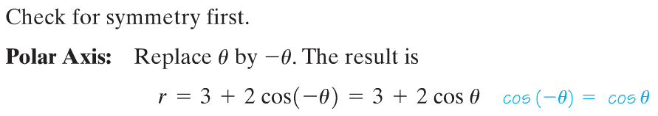
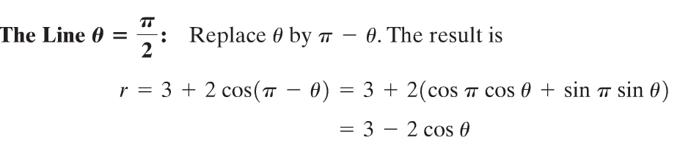
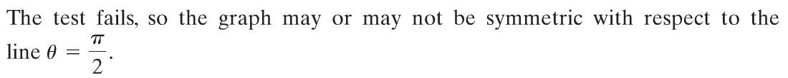
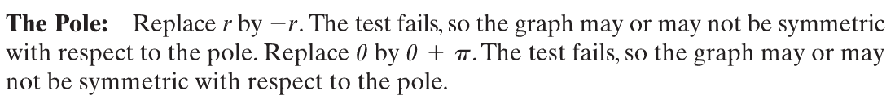
Copyright © 2012 Pearson Education, Inc. Publishing as Prentice Hall.

Slide 24
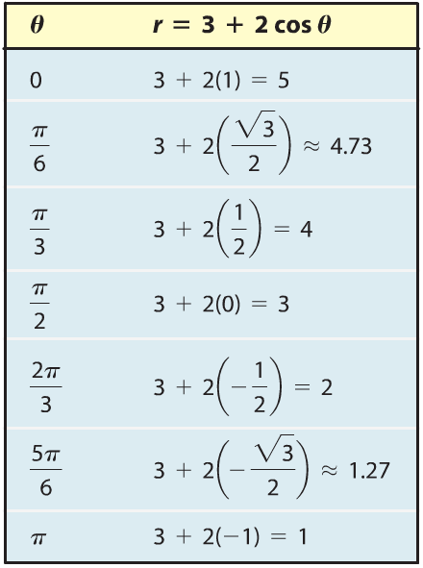
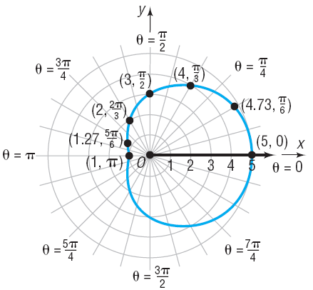
Copyright © 2012 Pearson Education, Inc. Publishing as Prentice Hall.

Slide 25
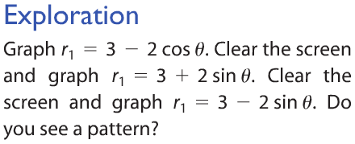



Copyright © 2012 Pearson Education, Inc. Publishing as Prentice Hall.

Slide 26
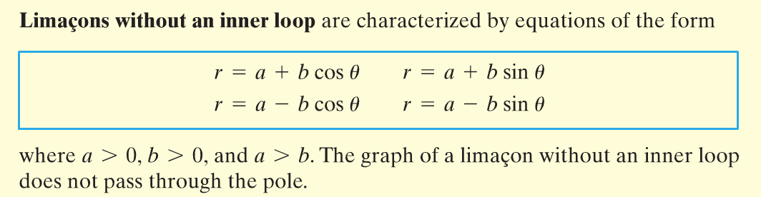
Copyright © 2012 Pearson Education, Inc. Publishing as Prentice Hall.

Slide 27
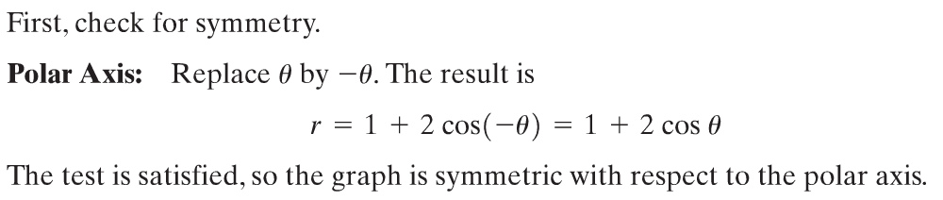
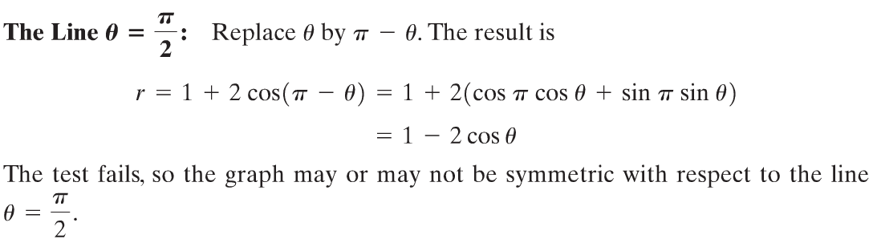
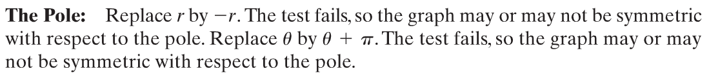
Copyright © 2012 Pearson Education, Inc. Publishing as Prentice Hall.

Slide 28
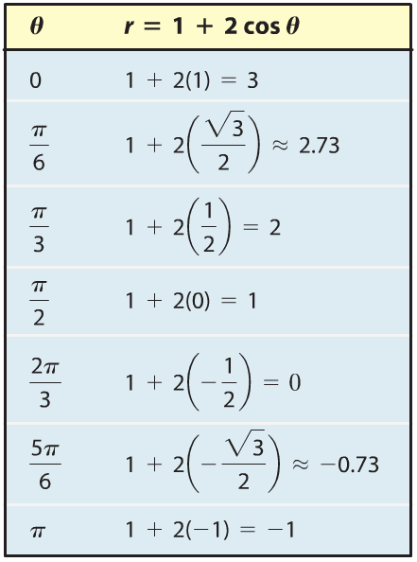
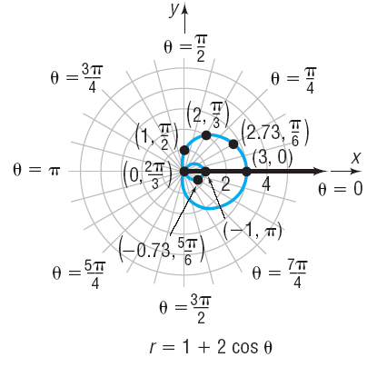
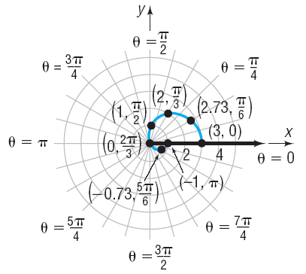
Copyright © 2012 Pearson Education, Inc. Publishing as Prentice Hall.

Slide 29
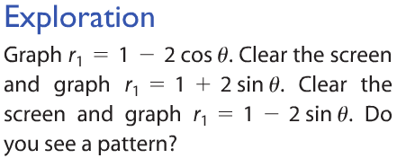



Copyright © 2012 Pearson Education, Inc. Publishing as Prentice Hall.

Slide 30
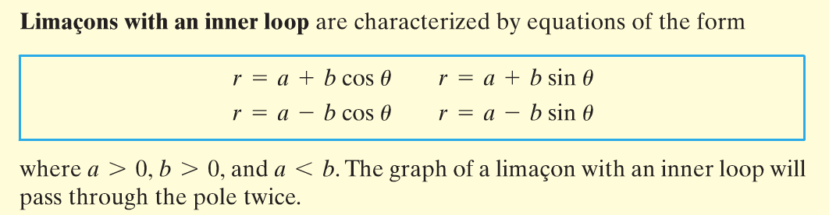
Copyright © 2012 Pearson Education, Inc. Publishing as Prentice Hall.

Slide 31

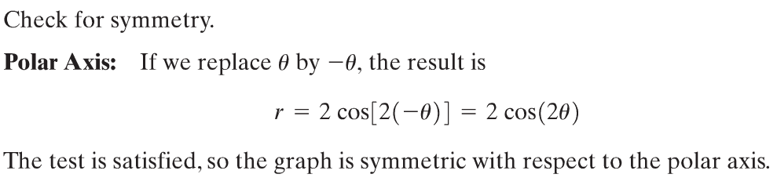
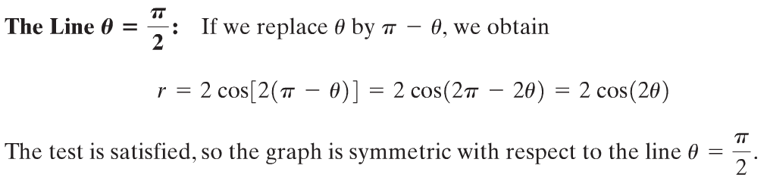
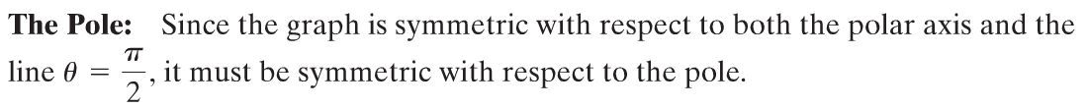
Copyright © 2012 Pearson Education, Inc. Publishing as Prentice Hall.

Slide 32
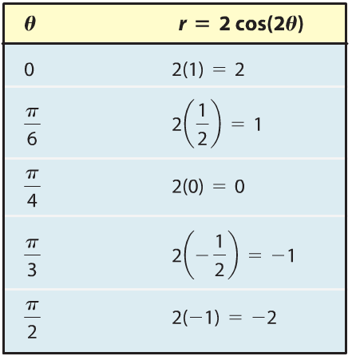
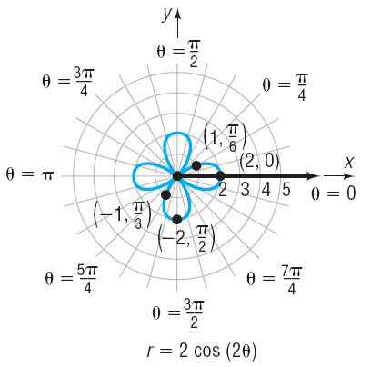

Copyright © 2012 Pearson Education, Inc. Publishing as Prentice Hall.

Slide 33







Copyright © 2012 Pearson Education, Inc. Publishing as Prentice Hall.

Slide 34

Copyright © 2012 Pearson Education, Inc. Publishing as Prentice Hall.

Slide 35


Copyright © 2012 Pearson Education, Inc. Publishing as Prentice Hall.

Slide 36



Copyright © 2012 Pearson Education, Inc. Publishing as Prentice Hall.

Slide 37

Copyright © 2012 Pearson Education, Inc. Publishing as Prentice Hall.

Slide 38


Copyright © 2012 Pearson Education, Inc. Publishing as Prentice Hall.

Slide 39


Copyright © 2012 Pearson Education, Inc. Publishing as Prentice Hall.

Slide 40

Copyright © 2012 Pearson Education, Inc. Publishing as Prentice Hall.

Slide 41

Copyright © 2012 Pearson Education, Inc. Publishing as Prentice Hall.

Slide 42

Copyright © 2012 Pearson Education, Inc. Publishing as Prentice Hall.

Slide 43

Copyright © 2012 Pearson Education, Inc. Publishing as Prentice Hall.

Slide 44



Copyright © 2012 Pearson Education, Inc. Publishing as Prentice Hall.

